Slide 1
CS2005 Database Systems
Fall 2022
National University of Computer and Emerging Sciences

Slide 2
CHAPTER 6
BASIC SQL

Slide 3
Basic SQL
SQL language
Considered one of the major reasons for the commercial success of relational databases
SQL
The origin of SQL is relational predicate calculus called tuple calculus (see Ch.8) which was proposed initially as the language SQUARE.
SQL Actually comes from the word “SEQUEL” which was the original term used in the paper: “SEQUEL TO SQUARE” by Chamberlin and Boyce. IBM could not copyright that term, so they abbreviated to SQL and copyrighted the term SQL.
Now popularly known as “Structured Query language”.
SQL is an informal or practical rendering of the relational data model with syntax

Slide 4
The CREATE TABLE Command in SQL
Specifying a new relation
Provide name of table
Specify attributes, their types and initial constraints
Can optionally specify schema:
CREATE TABLE COMPANY.EMPLOYEE ...
OR
CREATE TABLE EMPLOYEE ...

Slide 5
The CREATE TABLE Command in SQL (cont’d.)
Base tables (base relations)
Relation and its tuples are actually created and stored as a file by the DBMS
Virtual relations (views)
Created through the CREATE VIEW statement. Do not correspond to any physical file.
Attribute Data Types and Domains in SQL
The basic data types available for attributes include numeric, character string, bit string, Boolean, date, and time.

Slide 6
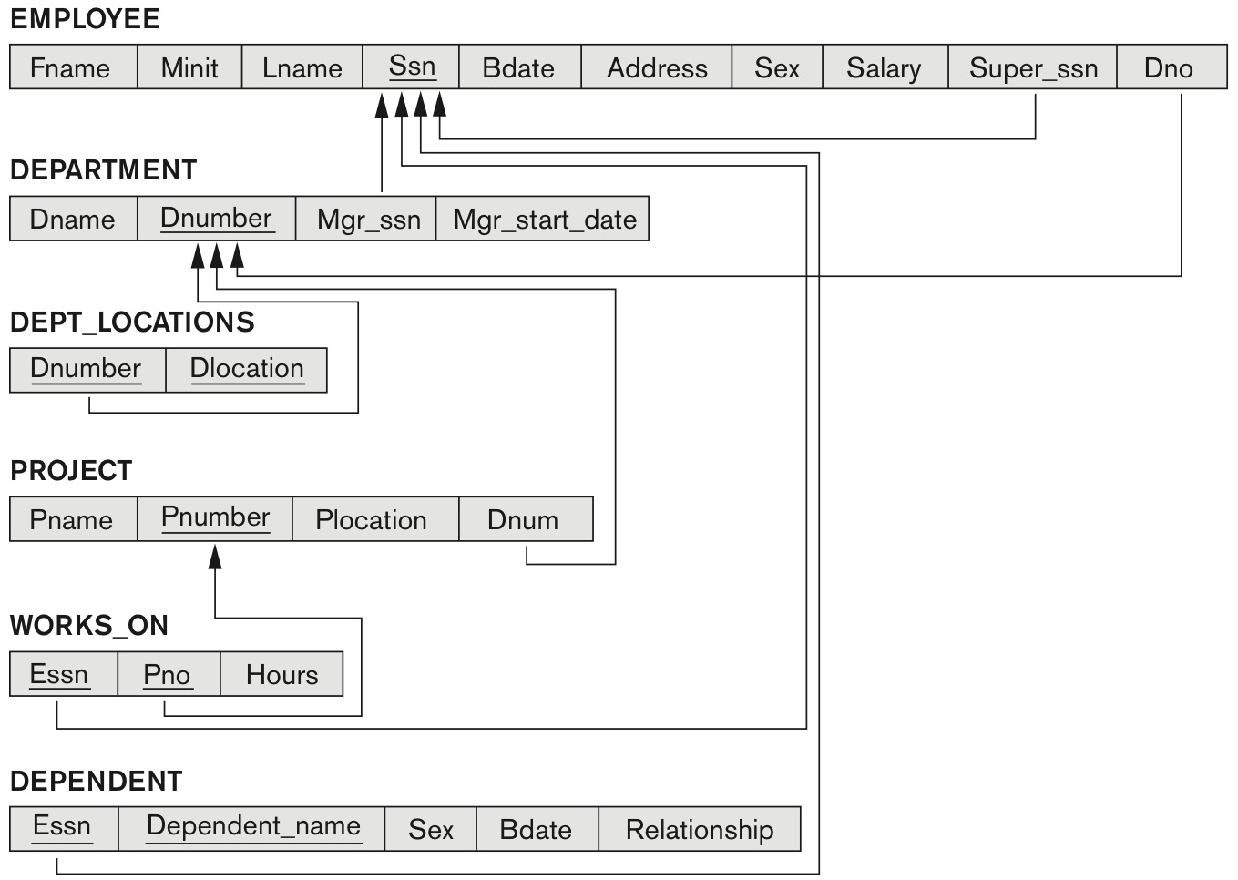
COMPANY relational database schema (Fig. 5.7)

Slide 7
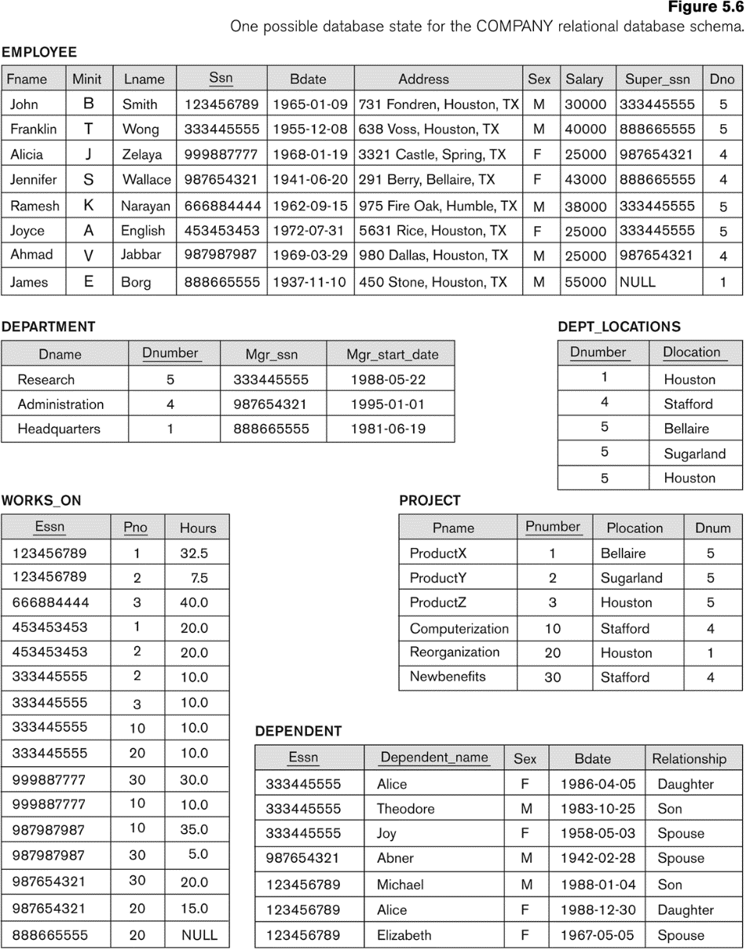

Slide 8
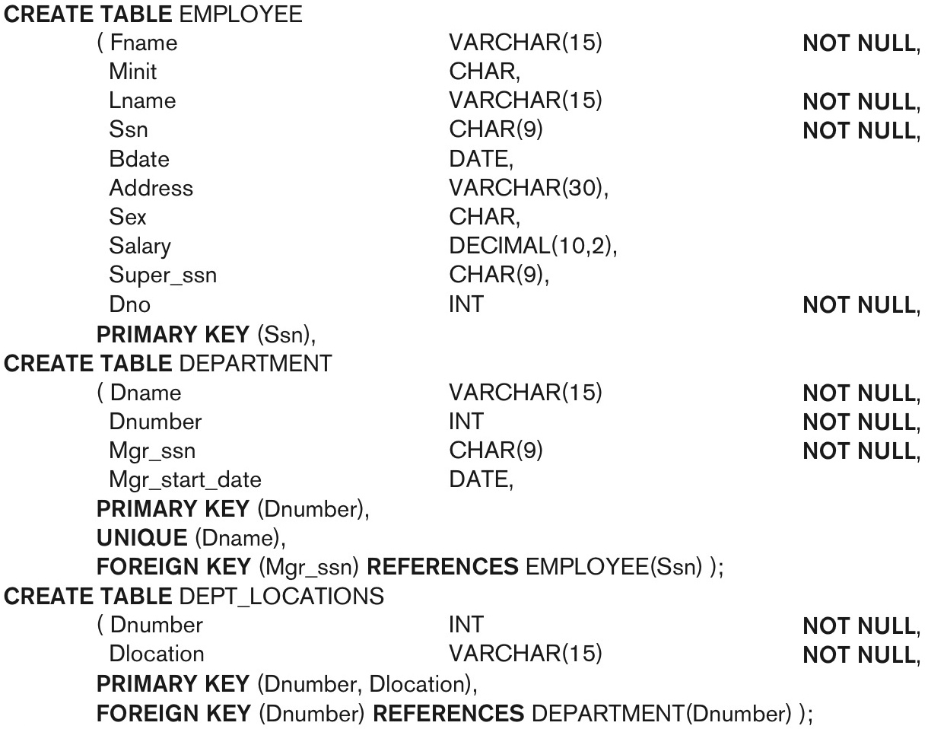
continued on next slide

Slide 9
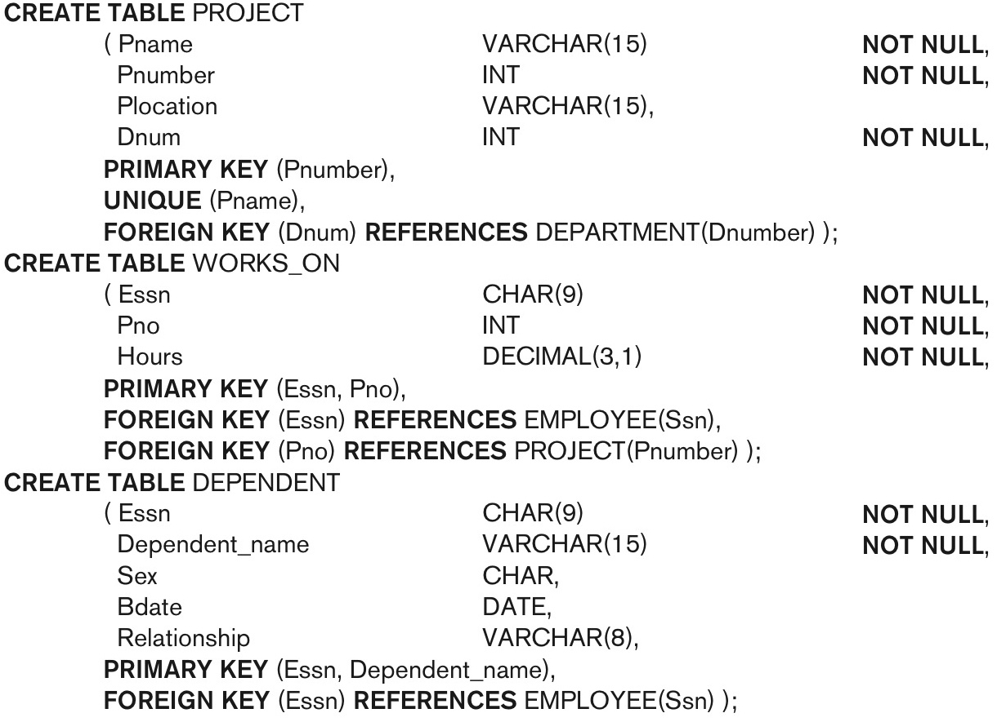
SQL CREATE TABLE data definition statements for defining the COMPANY schema from Figure 5.7 (Fig. 6.1)-continued

Slide 10
Specifying Constraints in SQL
Basic constraints:
Relational Model has 3 basic constraint types that are supported in SQL:
Key constraint: A primary key value cannot be duplicated
Entity Integrity Constraint: A primary key value cannot be null
Referential integrity constraints : The “foreign key “ must have a value that is already present as a primary key, or may be null.

Slide 11
Specifying Attribute Constraints and Attribute Defaults
A constraint NOT NULL may be specified if NULL is not permitted for a particular attribute.
This is always implicitly specified for the attributes that are part of the primary key of each relation, but it can be specified for any other attributes whose values are required not to be NULL
It is also possible to define a default value for an attribute by appending the clause DEFAULT <value> to an attribute definition.
The default value is included in any new tuple if an explicit value is not provided for that attribute

Slide 12
Specifying Attribute Constraints and Attribute Defaults
Another type of constraint can restrict attribute or domain values using the CHECK clause following an attribute or domain definition
Dnumber INT NOT NULL CHECK (Dnumber > 0 AND Dnumber < 21);
Additional Constraints on individual tuples within a relation are also possible using CHECK
CHECK clauses at the end of a CREATE TABLE statement
Apply to each tuple individually
CHECK (Dept_create_date <= Mgr_start_date);

Slide 13
Specifying Key and Referential Integrity Constraints
PRIMARY KEY clause
Specifies one or more attributes that make up the primary key of a relation
Dnumber INT PRIMARY KEY;
UNIQUE clause
Specifies alternate (secondary) keys (called CANDIDATE keys in the relational model).
Dname VARCHAR(15) UNIQUE;

Slide 14
Specifying Key and Referential Integrity Constraints (cont’d.)
FOREIGN KEY clause
Default operation: reject update on violation
Attach referential triggered action clause
Options include SET NULL, CASCADE, and SET DEFAULT
Action taken by the DBMS for SET NULL or SET DEFAULT is the same for both ON DELETE and ON UPDATE
CASCADE option suitable for “relationship” relations

Slide 15
Giving Names to Constraints
Using the Keyword CONSTRAINT
Name a constraint
Useful for later altering

Slide 16
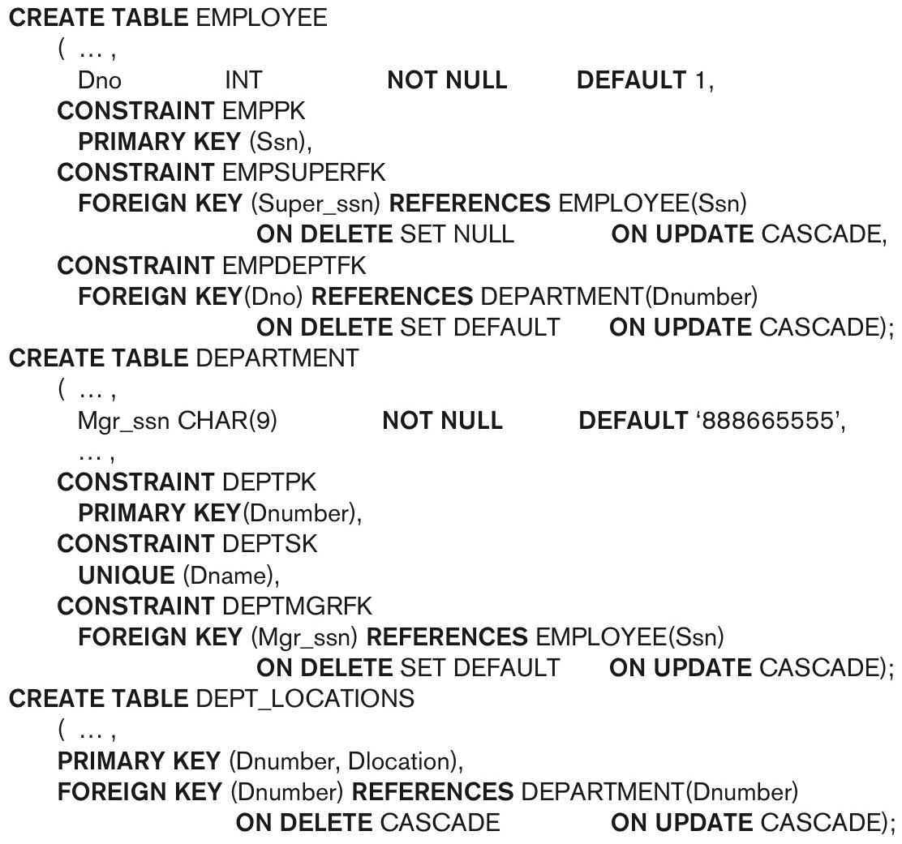
Default attribute values and referential integrity triggered action specification (Fig. 6.2)

Slide 17
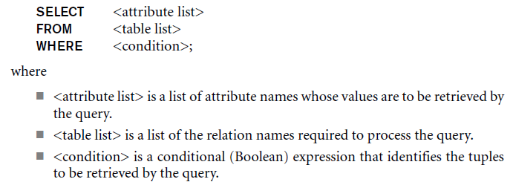
Basic Retrieval SQL Queries: The SELECT-FROM-WHERE
Basic form of the SELECT statement:

Slide 18
The SELECT-FROM-WHERE Structure of Basic SQL Queries (cont’d.)
Logical comparison operators
=, <, <=, >, >=, and <>
Projection attributes
Attributes whose values are to be retrieved
Selection condition
Boolean condition that must be true for any retrieved tuple. Selection conditions include join conditions when multiple relations are involved.

Slide 19
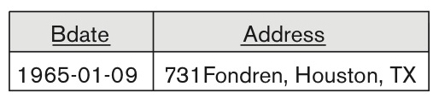
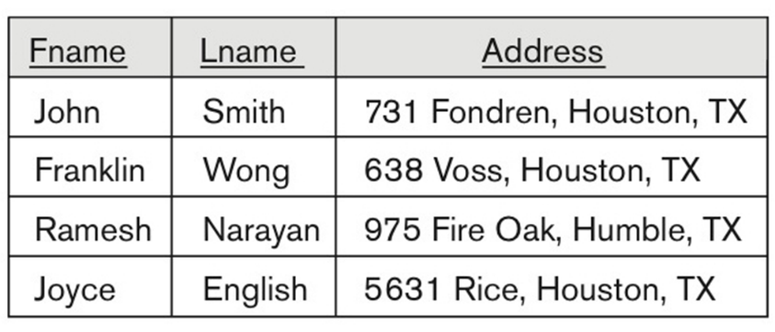
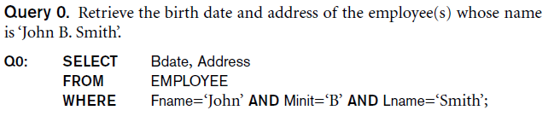
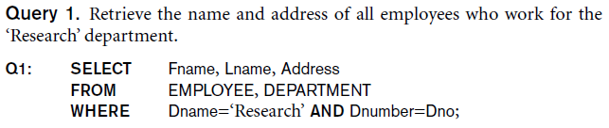
Basic Retrieval Queries

Slide 20
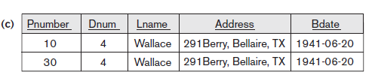
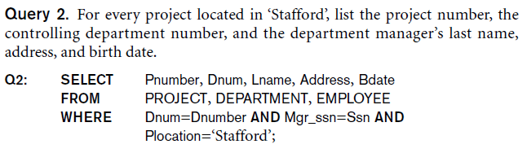
Basic Retrieval Queries (Contd.)

Slide 21

Ambiguous Attribute Names
Same name can be used for two (or more) attributes in different relations
As long as the attributes are in different relations
Must qualify the attribute name with the relation name to prevent ambiguity

Slide 22
Aliasing, and Renaming
Aliases or tuple variables
Declare alternative relation names E and S to refer to the EMPLOYEE relation twice in a query:
Query 8. For each employee, retrieve the employee’s first and last name and the first and last name of his or her immediate supervisor.
SELECT E.Fname, E.Lname, S.Fname, S.Lname
FROM EMPLOYEE AS E, EMPLOYEE AS S
WHERE E.Super_ssn=S.Ssn;
Recommended practice to abbreviate names and to prefix same or similar attribute from multiple tables.

Slide 23
Aliasing,Renaming and Tuple Variables (contd.)
The attribute names can also be renamed
EMPLOYEE AS E(Fn, Mi, Ln, Ssn, Bd, Addr, Sex, Sal, Sssn, Dno)
Note that the relation EMPLOYEE now has a variable name E which corresponds to a tuple variable
The “AS” may be dropped in most SQL implementations

Slide 24
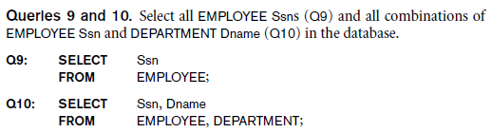
Unspecified WHERE Clause and Use of the Asterisk
Missing WHERE clause
Indicates no condition on tuple selection
Effect is a CROSS PRODUCT
Result is all possible tuple combinations (or the Algebra operation of Cartesian Product– see Ch.8) result

Slide 25
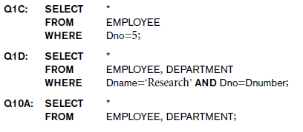
Unspecified WHERE Clause and Use of the Asterisk (cont’d.)
Specify an asterisk (*)
Retrieve all the attribute values of the selected tuples
The * can be prefixed by the relation name; e.g., EMPLOYEE *

Slide 26
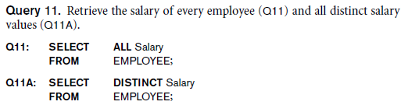
Tables as Sets in SQL
SQL does not automatically eliminate duplicate tuples in query results
For aggregate operations (See sec 7.1.7) duplicates must be accounted for
Use the keyword DISTINCT in the SELECT clause
Only distinct tuples should remain in the result

Slide 27
SQL has directly incorporated some of the set operations from mathematical set: set union (UNION), set difference (EXCEPT), set intersection (INTERSECT) operations
The relations resulting from these set operations are sets of tuples; that is, duplicate tuples are eliminated from the result.
These set operations apply only to typecompatible relations, so we must make sure that the two relations on which we apply the operation have the same attributes and that the attributes appear in the same order in both relations.

Slide 28
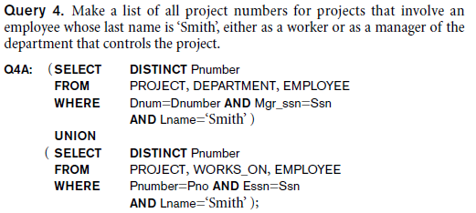
Tables as Sets in SQL (cont’d.)
Set operations
UNION, EXCEPT (difference), INTERSECT
Corresponding multiset operations: UNION ALL, EXCEPT ALL, INTERSECT ALL)
Type compatibility is needed for these operations to be valid

Slide 29
Substring Pattern Matching and Arithmetic Operators
LIKE comparison operator
Used for string pattern matching
% replaces an arbitrary number of zero or more characters
underscore (_) replaces a single character
Examples: WHERE Address LIKE ‘%Houston,TX%’;
WHERE Ssn LIKE ‘_ _ 1_ _ 8901’;
BETWEEN comparison operator
WHERE(Salary BETWEEN 30000 AND 40000) AND Dno = 5;

Slide 30
Arithmetic Operations
Standard arithmetic operators:
Addition (+), subtraction (–), multiplication (*), and division (/) may be included as a part of SELECT
Query 13. Show the resulting salaries if every employee working on the ‘ProductX’ project is given a 10 percent raise.
SELECT E.Fname, E.Lname, 0.1 * E.Salary AS Increased_sal
FROM EMPLOYEE AS E, WORKS_ON AS W, PROJECT AS P
WHERE E.Ssn=W.Essn AND W.Pno=P.Pnumber AND P.Pname=‘ProductX’;

Slide 31
Ordering of Query Results
Use ORDER BY clause
Keyword DESC to see result in a descending order of values
Keyword ASC to specify ascending order explicitly
Typically placed at the end of the query
ORDER BY D.Dname DESC, E.Lname ASC, E.Fname ASC

Slide 32
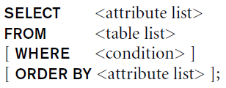
Basic SQL Retrieval Query Block

Slide 33
INSERT, DELETE, and UPDATE Statements in SQL
Three commands used to modify the database:
INSERT, DELETE, and UPDATE
INSERT typically inserts a tuple (row) in a relation (table)
UPDATE may update a number of tuples (rows) in a relation (table) that satisfy the condition
DELETE may also update a number of tuples (rows) in a relation (table) that satisfy the condition

Slide 34
INSERT
In its simplest form, it is used to add one or more tuples to a relation
Attribute values should be listed in the same order as the attributes were specified in the CREATE TABLE command
Constraints on data types are observed automatically
Any integrity constraints as a part of the DDL specification are enforced

Slide 35


The INSERT Command
Specify the relation name and a list of values for the tuple. All values including nulls are supplied.
Notes:
A DBMS that fully implements SQL should support and enforce all the integrity constraints that can be specified in the DDL.

Slide 36
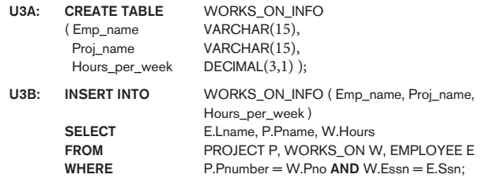
The INSERT Command
The variation below inserts multiple tuples where a new table is loaded values from the result of a query.

Slide 37
BULK LOADING OF TABLES
Another variation of INSERT is used for bulk-loading of several tuples into tables
A new table TNEW can be created with the same attributes as T and using LIKE and DATA in the syntax, it can be loaded with entire data.
EXAMPLE:
CREATE TABLE D5EMPS LIKE EMPLOYEE
SELECT E.*
FROM EMPLOYEE AS E
WHERE E.Dno=5)
WITH DATA;

Slide 38
DELETE
Removes tuples from a relation
Includes a WHERE-clause to select the tuples to be deleted
Referential integrity should be enforced
Tuples are deleted from only one table at a time (unless CASCADE is specified on a referential integrity constraint)
A missing WHERE-clause specifies that all tuples in the relation are to be deleted; the table then becomes an empty table
The number of tuples deleted depends on the number of tuples in the relation that satisfy the WHERE-clause

Slide 39
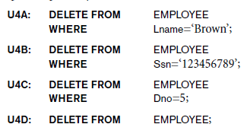
The DELETE Command
Removes tuples from a relation
Includes a WHERE clause to select the tuples to be deleted. The number of tuples deleted will vary.

Slide 40
UPDATE
Used to modify attribute values of one or more selected tuples
A WHERE-clause selects the tuples to be modified
An additional SET-clause specifies the attributes to be modified and their new values
Each command modifies tuples in the same relation
Referential integrity specified as part of DDL specification is enforced

Slide 41
UPDATE (contd.)
Example: Change the location and controlling department number of project number 10 to 'Bellaire' and 5, respectively
U5: UPDATE PROJECT
SET PLOCATION = 'Bellaire', DNUM=5
WHERE PNUMBER=10

Slide 42
UPDATE (contd.)
Example: Give all employees in the 'Research' department a 10% raise in salary.
U6: UPDATE EMPLOYEE
SET SALARY = SALARY *1.1
WHERE DNO IN (SELECT DNUMBER
FROM DEPARTMENT
WHERE DNAME='Research')
In this request, the modified SALARY value depends on the original SALARY value in each tuple
The reference to the SALARY attribute on the right of = refers to the old SALARY value before modification
The reference to the SALARY attribute on the left of = refers to the new SALARY value after modification

